Slide 1
Digital Art NFT Gallery
Ankush Tiwari
Under the guidance of
Prachiti Sonawane

Slide 2
ABSTRACT
This project is a SQL database built to manage a Digital Art NFT Gallery. It uses a relational schema to track artists, collectors, artworks, and all sales transactions. The database can run complex analytical queries to find top collectors, total artist sales volume, and collection floor prices, serving as a case study in building a database for a modern digital marketplace.

Slide 3
Table of contents
1
ER - DIAGRAM
2
STRUCTURE OF TABLE
3
CONTENTS OF TABLE
4
SUBQUERY
5
JOINS
6
Views

Slide 4
1
ER-DIAGRAM

Slide 5
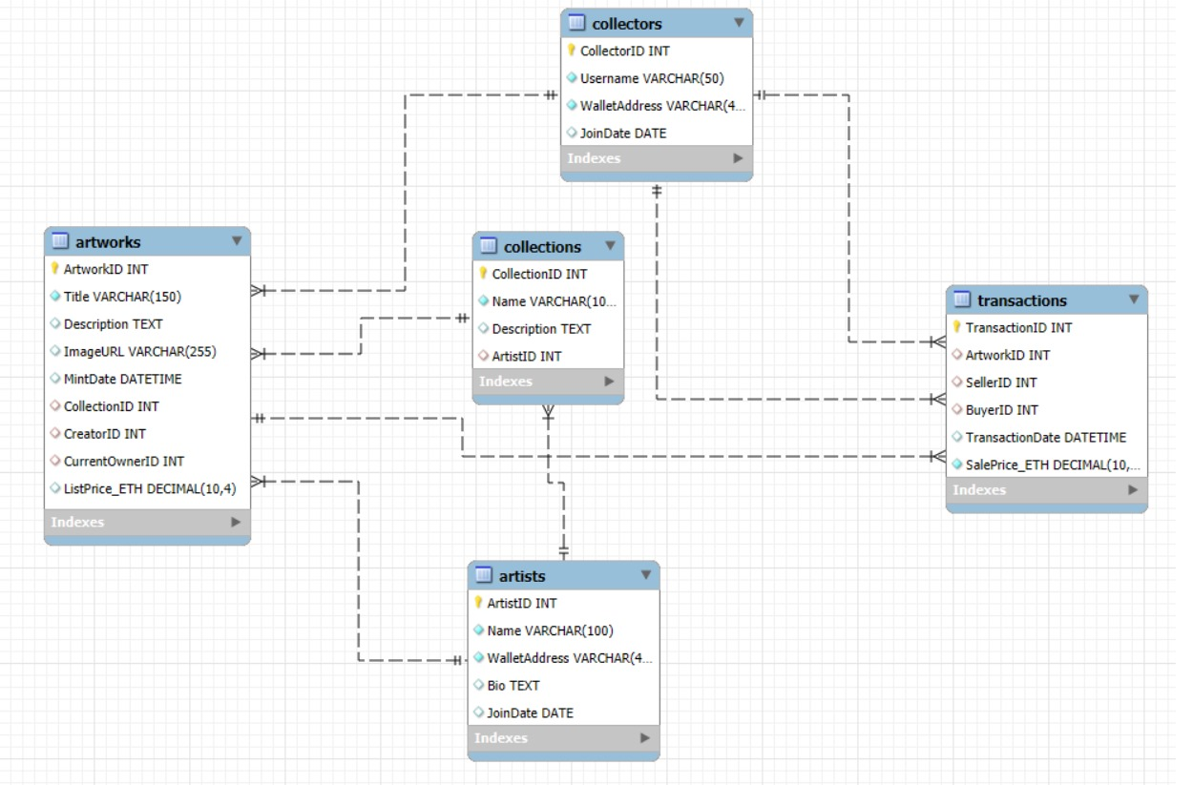
ER-DIAGRAM

Slide 6
STRUCTURE OF TABLE
2

Slide 7
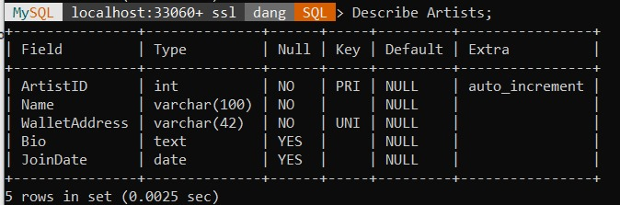
ARTISTS TABLE
This table stores information about the creators of digital art. It includes their name, wallet address, and join date.
Syntax: DESCRIBE Artists;

Slide 8
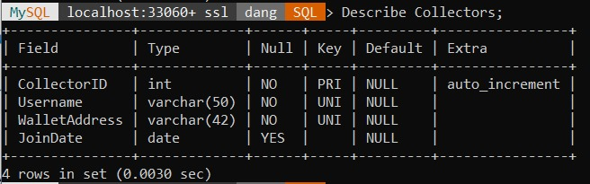
COLLECTORS TABLE
This table keeps track of all users who can buy and own NFTs. It stores their username and wallet address.
Syntax: DESCRIBE Collectors;

Slide 9
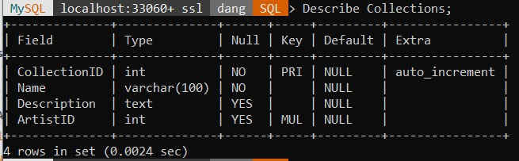
COLLECTIONS TABLE
This table groups artworks together, usually by the same artist. It links back to the artist who created the collection.
Syntax: DESCRIBE Collections;

Slide 10
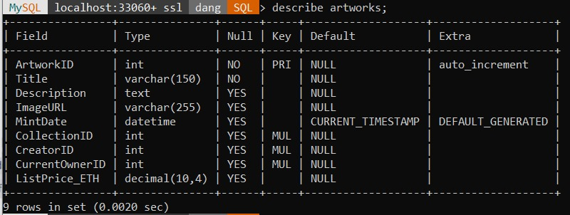
ARTWORKS TABLE
This table shows all the individual artworks in the gallery. It tracks the title, creator, current owner, and price.
Syntax: Describe Artworks;

Slide 11
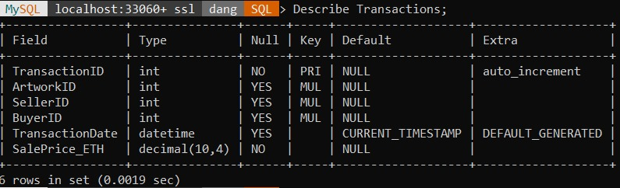
TRANSACTIONS TABLE
This table records every sale that happens in the gallery. It links the artwork, the seller, the buyer, and the sale price.
Syntax: DESCRIBE Transactions;

Slide 12
CONTENTS OF TABLE
3

Slide 13
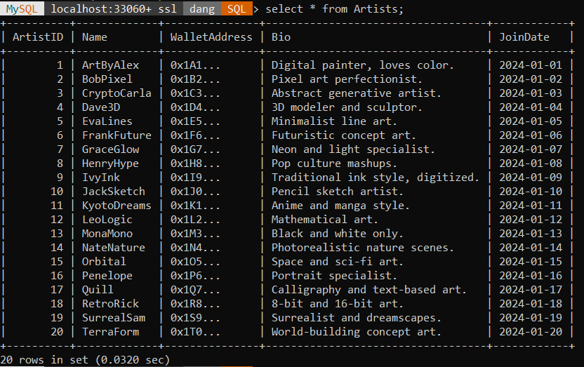
TABLE OF ARTISTS

Slide 14
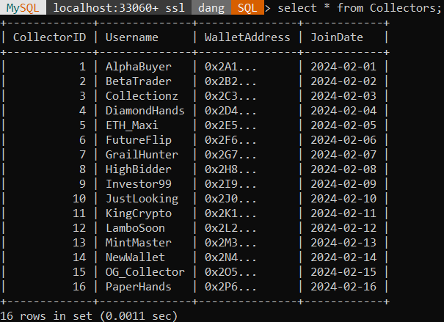
TABLE OF COLLECTION

Slide 15
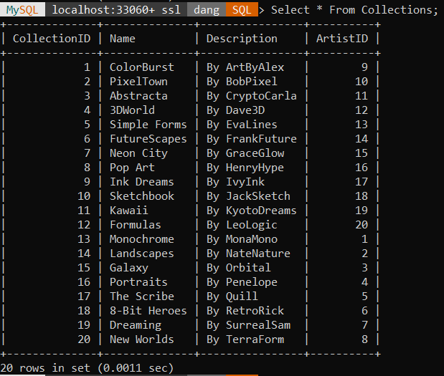
TABLE OF COLLECTIONS

Slide 16
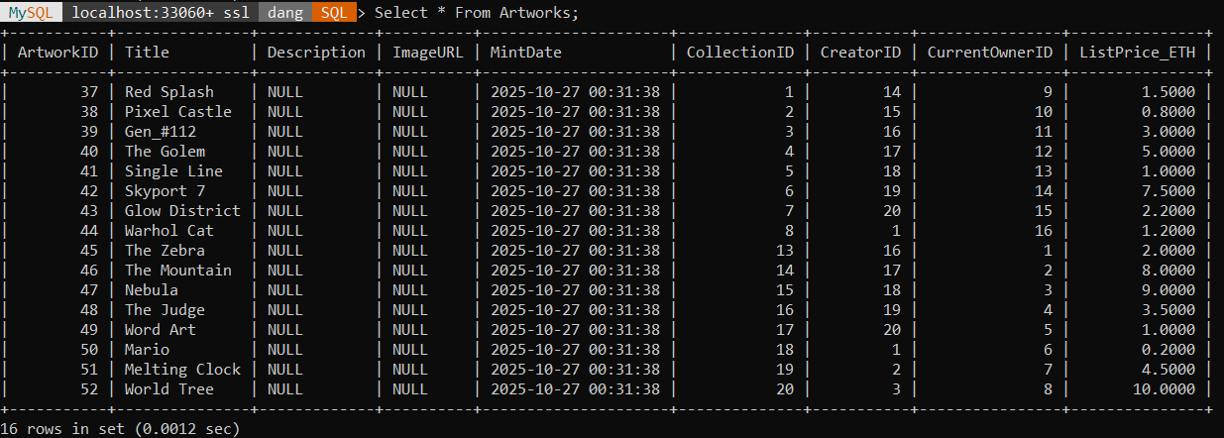
TABLE OF ARTWORKS

Slide 17
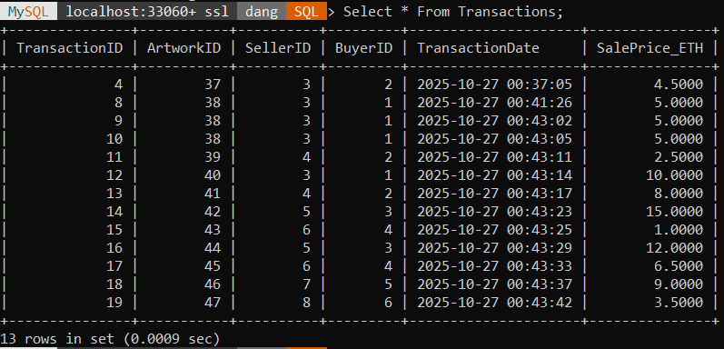
TABLE OF TRANSACTIONS

Slide 18
4
SUBQUERY

Slide 19
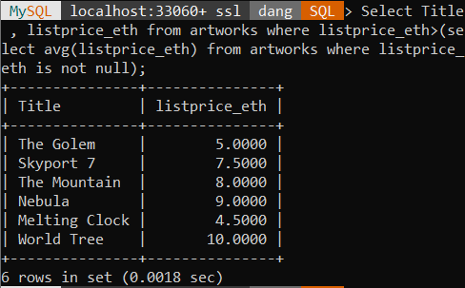
Display artworks are listed for more than the average price.
SYNTAX: SELECT Title, ListPrice_ETH
FROM Artworks
WHERE ListPrice_ETH > (
SELECT AVG(ListPrice_ETH)
FROM Artworks
WHERE ListPrice_ETH IS NOT NULL
);

Slide 20
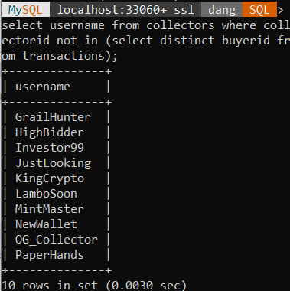
Display the collectors who haven't bought anything yet
SYNTAX: SELECT Username
FROM Collectors
WHERE CollectorID NOT IN (
SELECT DISTINCT BuyerID
FROM Transactions
);

Slide 21
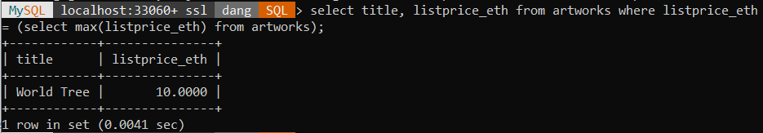
Display the single most expensive artwork currently listed for sale.
SYNTAX: SELECT Title, ListPrice_ETH
FROM Artworks
WHERE ListPrice_ETH = (
SELECT MAX(ListPrice_ETH)
FROM Artworks
);

Slide 22
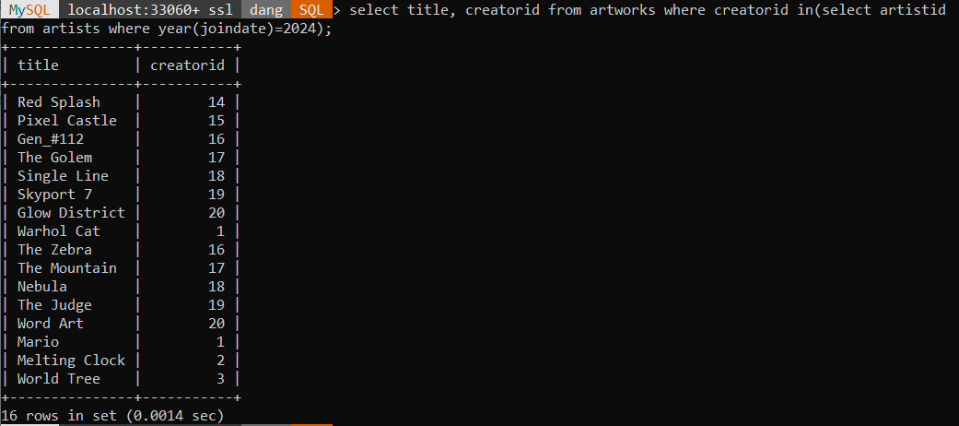
Display the all artworks created by artists who joined this year.
SYNTAX: SELECT Title, CreatorID
FROM Artworks
WHERE CreatorID IN (
SELECT ArtistID
FROM Artists
WHERE YEAR(JoinDate) = 2024
);

Slide 23
5
JOINS

Slide 24
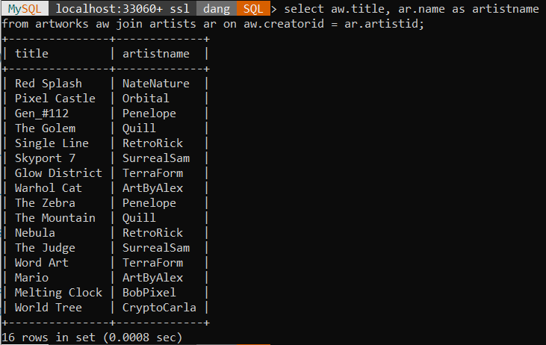
Display List all artworks and who made them.
SYNTAX: SELECT
aw.Title,
ar.Name AS ArtistName
FROM Artworks aw
JOIN Artists ar ON aw.CreatorID = ar.ArtistID;

Slide 25
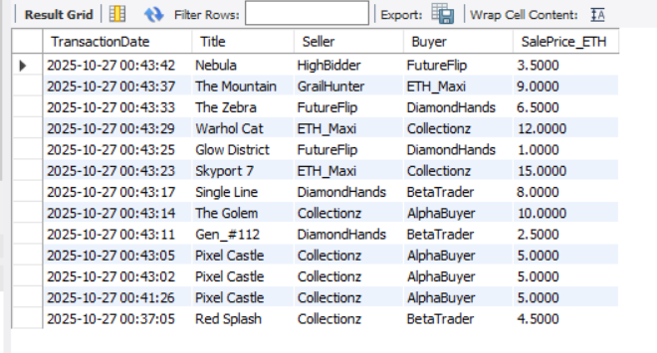
Display a full sales report: date, artwork title, seller , buyer , and price.
SYNTAX: Select t.TransactionDate, a.Title, seller.Username AS Seller, buyer.Username AS Buyer, t.SalePrice_ETH FROM Transactions t
JOIN Artworks a ON t.ArtworkID = a.ArtworkID
JOIN Collectors seller ON t.SellerID = seller.CollectorID
JOIN Collectors buyer ON t.BuyerID = buyer.CollectorID
ORDER BY t.TransactionDate DESC;

Slide 26
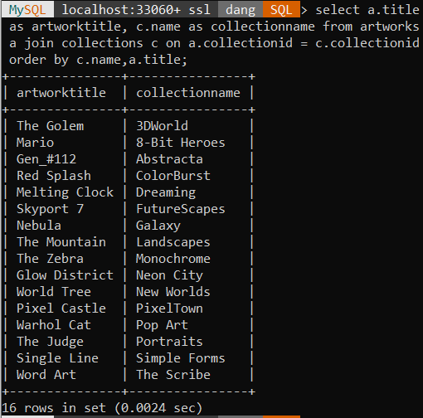
Display all artworks and the name of the collection they belong to.
SYNTAX: SELECT
a.Title AS ArtworkTitle,
c.Name AS CollectionName
FROM Artworks a
JOIN Collections c ON a.CollectionID = c.CollectionID
ORDER BY c.Name, a.Title;

Slide 27
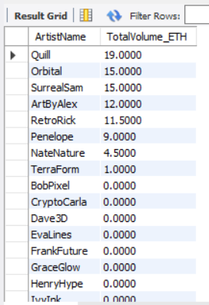
Display all artists by how much they've sold.
SYNTAX: Select
ar.Name AS ArtistName,
IFNULL(SUM(t.SalePrice_ETH), 0) AS TotalVolume_ETH
FROM Artists ar
LEFT JOIN Artworks aw ON ar.ArtistID = aw.CreatorID
LEFT JOIN Transactions t ON aw.ArtworkID = t.ArtworkID
GROUP BY ar.Name
ORDER BY TotalVolume_ETH DESC;

Slide 28
6
VIEWS

Slide 29
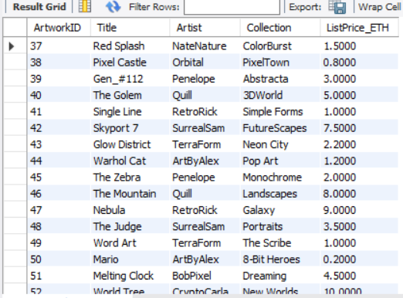
Let's create an easy way to see all items currently for sale, called ItemsForSaleView.
SYNTAX: CREATE VIEW ItemsForSaleView AS
SELECT a.ArtworkID, a.Title,
ar.Name AS Artist, c.Name AS Collection,
a.ListPrice_ETH FROM Artworks a
JOIN Artists ar ON a.CreatorID = ar.ArtistID
JOIN Collections c ON a.CollectionID = c.CollectionID
WHERE a.ListPrice_ETH IS NOT NULL;

Slide 30
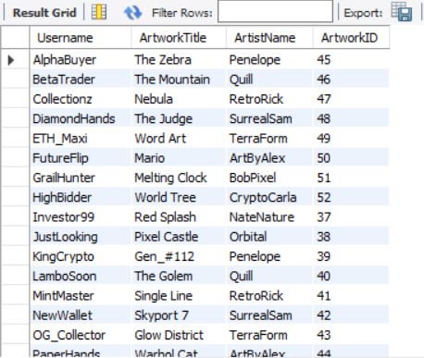
Make a view called CollectorPortfolioView to easily check any collector's current holdings.
SYNTAX: CREATE VIEW CollectorPortfolioView AS
Select col.Username, a.Title AS ArtworkTitle,
ar.Name AS ArtistName, a.ArtworkID
FROM Collectors col
JOIN Artworks a ON col.CollectorID = a.CurrentOwnerID
JOIN Artists ar ON a.CreatorID = ar.ArtistID;

Slide 31
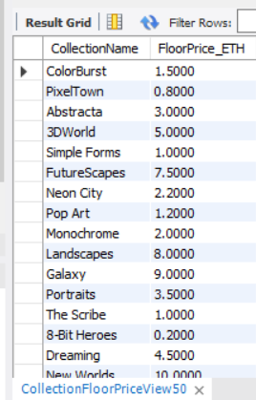
Create a view called CollectionFloorPriceView to quickly see the cheapest item in each collection.
SYNTAX: CREATE VIEW CollectionFloorPriceView AS
Select
c.Name AS CollectionName,
MIN(a.ListPrice_ETH) AS FloorPrice_ETH
FROM Collections c
JOIN Artworks a ON c.CollectionID = a.CollectionID
WHERE a.ListPrice_ETH IS NOT NULL
GROUP BY c.Name;

Slide 32
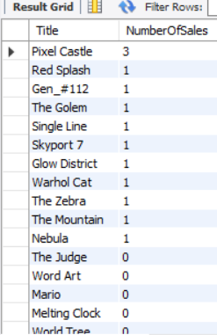
Create a view named ArtworkSaleCount showing the number of sales per artwork.
SYNTAX: CREATE VIEW ArtworkSaleCount AS
SELECT
a.Title,
COUNT(t.TransactionID) AS NumberOfSales
FROM Artworks a
LEFT JOIN Transactions t ON a.ArtworkID = t.ArtworkID
GROUP BY a.ArtworkID, a.Title
ORDER BY NumberOfSales DESC;

Slide 33

Thanks!

